Slide 1
Fundamentals of Concurrency

Slide 2
Background Concepts
Application
Software Package
Process
Instance of app executing on device
Supports completing a set of related tasks
e.g. Google Chrome or Microsoft Word
Thread
Lightweight execution stream within process
Each process has its own memory, data, code, and operating system resources
Each thread shares memory, data, and code within a process, but has its own execution stream (PC counter, registers, and stack)

Slide 3
Operating System Concurrency
Modern hardware has sufficient resources to run many applications and threads simultaneously.
People have multiple processes open simultaneously, such as a web browser, Word, a messaging app, and file explorer.
Processes typically have multiple threads running simultaneously for better performance and responsiveness:
Common example: the user interface can continue responding on one thread while the process is performing other tasks
Tasks can be broken into subtasks and run in parallel for speed
Can utilize multiple processors in some cases

Slide 4
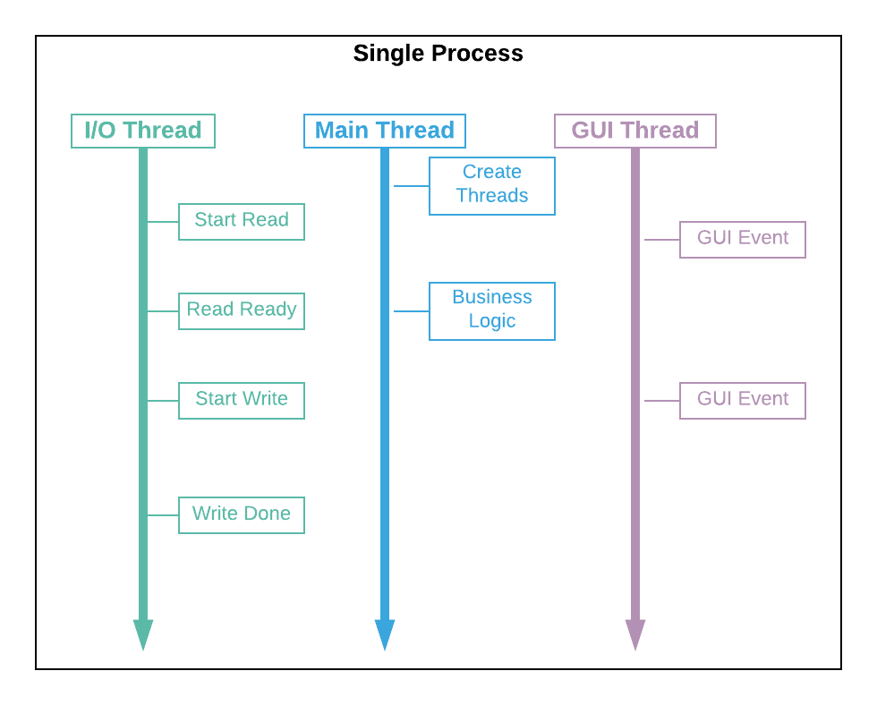
Multithreading Visual

Slide 5
Types of Schedulers
Native
Operating system schedules threads
User
Process (JVM) schedules threads
Threads in one process can run on multiple processors
Process restricted to a single processor

Slide 6
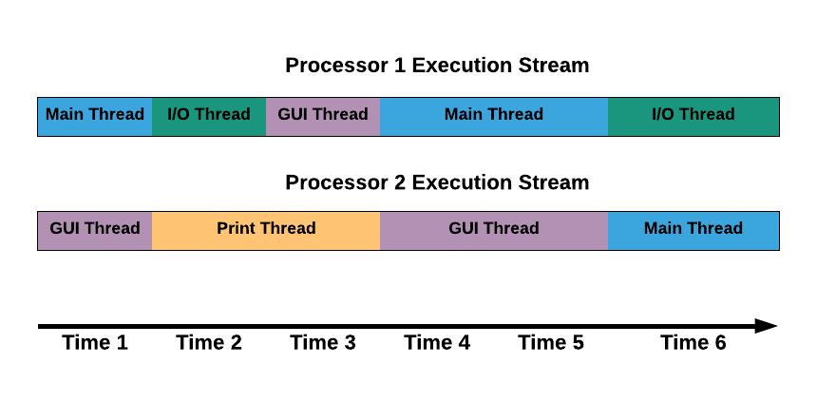
Scheduling Visual
Notes:
The scheduler keeps certain requirements to help ensure all threads execute in an orderly fashion.
However, the ordering of any particular set of threads is not guaranteed and can vary from execution to execution, device to device.
There are ways to prioritize threads and control some aspects of their execution.
It’s very important to verify thread interoperability at a conceptual level because you cannot rely on tests alone.

Slide 7
Thread Implementation in Java
Runnable Interface
Multiple ways to create
Suitable for Long-Running
Callable Interface
Can return value when done
Suitable for Shorter Tasks

Slide 8
Callable/Runnable Notes
Classes that implement either interface can be used to create a separate stream of execution.
Both are functional interfaces with a single public method, so are suitable for lambdas.
Note that an object implementing either interface is not a stream of execution in itself; the stream of execution happens behind the scenes; the object is a placeholder for starting and interacting with the stream of execution.
Concurrency is not an object-oriented concept.

Slide 9
Types of Threads in Java
When the JVM starts, it creates a thread named “Main” that executes the public static void main(...) method.
The main thread may create child threads to perform various tasks as needed.
The JVM designates each thread as either “daemon” or “user” (the default us “user”).
The JVM will not exit until all user threads have terminated (not so with daemon threads).

Slide 10
Thread States in Java
State | Explanation
New | The thread was just created but not yet runnable.
Runnable | The thread is ready to be executed. It may or may not be currently running depending upon scheduler.
Blocked/Waiting | The thread is temporarily inactive because it’s waiting on a lock, resource, or a notification.
Timed Wait | The thread is temporarily inactive for a specific amount of time (which can be preempted).
Terminated | The thread has finished executing (successfully or unsuccessfully) and is no longer scheduled to run.

Slide 11
Basic Thread Control in Java
Operation | Explanation
Thread.start() | Creates a new thread for a new stream of execution.
Thread.join() | The current thread waits for another thread to complete (optionally within a maximum wait time).
Thread.sleep() | The current thread becomes temporarily inactive for a specified period of time.
Thread.yield() | Gives a hint to the scheduler that another thread can be executed instead of the current thread.

Slide 12
Create by Extending Thread
public class DemoExtendThread {
public static void main(String[] args) {
ExtendThread ThreadA = new ExtendThread('A');
ExtendThread ThreadB = new ExtendThread('B');
ThreadA.start();
ThreadB.start();
}
}
class ExtendThread extends Thread {
private char ThreadID;
public ExtendThread(char ThreadID) {
this.ThreadID = ThreadID;
}
public void run() {
for (int i = 0; i < 15; i++)
{
System.out.print(" " + ThreadID + i);
}
}
}
Sample Run 1
B0 A0 A1 A2 A3 B1 A4 A5 A6 A7 A8 A9 A10 A11 B2 A12 B3 A13 A14 B4 B5 B6 B7 B8 B9 B10 B11 B12 B13 B14
Sample Run 2
A0 B0 A1 A2 A3 A4 A5 A6 A7 A8 A9 A10 A11 A12 A13 A14 B1 B2 B3 B4 B5 B6 B7 B8 B9 B10 B11 B12 B13 B14
Notes:
Any class that extends thread can be used to start a new stream of execution by instantiating it and using the start() method.
Thread implements the Runnable method.
Note that re-running with multiple streams of execution can result in different schedules.

Slide 13
Create by Implementing Runnable
public class DemoImplementRunnable {
public static void main(String[] args) {
Thread ThreadA = new Thread(new ImplementRunnable('A'));
Thread ThreadB = new Thread(new ImplementRunnable('B'));
ThreadA.start();
ThreadB.start();
}
}
class ImplementRunnable implements Runnable {
private char ThreadID;
public ImplementRunnable(char ThreadID) {
this.ThreadID = ThreadID;
}
public void run() {
for (int i = 0; i < 15; i++)
{
System.out.print(" " + ThreadID + i);
}
}
}
Sample Run 1
B0 A0 B1 A1 A2 B2 A3 A4 A5 B3 B4 B5 B6 B7 B8 B9 B10 B11 B12 B13 B14 A6 A7 A8 A9 A10 A11 A12 A13 A14
Sample Run 2
B0 B1 B2 B3 B4 A0 A1 A2 A3 A4 A5 A6 A7 A8 A9 A10 A11 A12 A13 A14 B5 B6 B7 B8 B9 B10 B11 B12 B13 B14
Notes:
Any class that implements runnable can be passed to the thread constructor to create a thread.
Yes, this includes any class that extends Thread (i.e. a Thread can take another Thread in its constructor).
The recommend approach between these two is to implement Runnable (there is no need to tie yourself to the Thread class).

Slide 14
Create as Callable with Future
public class DemoCallable {
public static void main(String[] args) {
try {
FutureTask<Integer> future = new FutureTask<Integer>(new ChildCallableThread());
Thread childThread = new Thread(future);
childThread.start();
int result = future.get();
System.out.println("The child thread's result is " + result);
}
catch (ExecutionException | InterruptedException e) {
e.printStackTrace();
}
}
private static class ChildCallableThread implements Callable<Integer> {
public Integer call() {
int retVal = 0;
for (int i = 0; i < 15; i++)
{
retVal += i;
}
return retVal;
}
}
}
Output
The child thread's result is 105
Notes:
Although a different interface is used, a thread is still started and runs the call() method.
The call() method can throw a specific exception, and returns a value.
The FutureTask object provides the ability to interact with the thread after it has been started.
FutureTask.get() waits until the thread returns the result and then gets the result.

Slide 15
Joining
public class DemoJoin {
public static void main(String[] args) {
try {
ThreadToJoin threadToJoin = new ThreadToJoin();
threadToJoin.start();
threadToJoin.join();
for (int i = 0; i < 15; i++)
{
System.out.print(" M" + i);
}
}
catch (InterruptedException e) {
e.printStackTrace();
}
}
private static class ThreadToJoin extends Thread {
public void run() {
for (int i = 0; i < 15; i++)
{
System.out.print(" C" + i);
}
}
}
}
Output
C0 C1 C2 C3 C4 C5 C6 C7 C8 C9 C10 C11 C12 C13 C14 M0 M1 M2 M3 M4 M5 M6 M7 M8 M9 M10 M11 M12 M13 M14
Notes:
Notice that the main thread (automatically created by the JVM) waits on the child thread to complete with a join, then performs its actions.
The output shows that the child thread ran in full, then the main thread.

Slide 16
Yielding
public class DemoYield {
public static void main(String[] args) {
ChildThread childThread = new ChildThread();
childThread.start();
for (int i = 0; i < 15; i++)
{
Thread.yield();
System.out.print(" M" + i);
}
}
private static class ChildThread extends Thread {
public void run() {
for (int i = 0; i < 15; i++)
{
System.out.print(" C" + i);
}
}
}
}
Sample Run 1
M0 C0 C1 C2 C3 M1 C4 C5 C6 C7 C8 C9 C10 C11 M2 C12 C13 M3 C14 M4 M5 M6 M7 M8 M9 M10 M11 M12 M13 M14
Sample Run 2
M0 C0 M1 C1 M2 C2 M3 C3 M4 C4 C5 C6 C7 C8 C9 C10 C11 C12 C13 C14 M5 M6 M7 M8 M9 M10 M11 M12 M13 M14
Notes:
The main thread yields before printing anything in the loop.
Notice that in the sample runs, the child thread mostly runs before the main thread, but the main thread still runs some before the child thread is completed.

Slide 17
Sleeping
public class DemoSleep {
public static void main(String[] args) {
try {
long firstMilli = System.currentTimeMillis();
Thread.sleep(1500);
long secondMilli = System.currentTimeMillis();
System.out.println((secondMilli-firstMilli) + " milliseconds have elapsed.");
}
catch (InterruptedException e) {
e.printStackTrace();
}
}
}
Sample Run 1
1500 milliseconds have elapsed.
Sample Run 2
1504 milliseconds have elapsed.
Notes:
The main thread grabs the milliseconds, sleeps, then grabs it again. Then it prints out how many millisecond have elapsed.

Slide 18
The Need for Threadpools
Some applications need to have large amounts tasks running in parallel, such as application servers, middleware servers, aggressive clients, and the like, on the order of thousands of threads if not more.
It is not efficient to continually decommission old threads and create new threads every time a new task is needed.
A threadpool re-uses threads (streams of execution, not to be confused with the Java Thread class) to avoid this inefficiency.

Slide 19
Executors and ExecutorService
The Executors class creates different types of threadpools for the app’s needs:
Statically sized thread pool for a fixed number of threads.
Dynamically sized thread pool that reuses threads if available, and creates new ones as needed.
Single threaded pool.
The ExecutorService subclasses act as both a threadpool and a means of creating and interacting with threads.

Slide 20
Fixed Size Threadpool Demo
public class DemoThreadpool {
public static void main(String[] args) {
ExecutorService threadpool = Executors.newFixedThreadPool(2);
threadpool.execute(new ChildThread("A"));
threadpool.execute(new ChildThread("B"));
threadpool.execute(new ChildThread("C"));
}
private static class ChildThread implements Runnable {
private String prefix;
public ChildThread(String prefix) {
this.prefix = prefix;
}
public void run() {
for (int i = 0; i < 10; i++)
{
System.out.print(" " + prefix + i);
}
}
}
}
Output
A0 B0 A1 B1 A2 B2 A3 A4 A5 A6 A7 B3 A8 B4 A9 B5 B6 B7 B8 B9 C0 C1 C2 C3 C4 C5 C6 C7 C8 C9
Notes:
A fixed size threadpool is created of size 2.
Three threads are added for execution but only 2 can be executed at a time.
That’s why C executes after all of the others.

Slide 21
Dynamic Threadpool Demo
public class DemoDynamicThreadpool {
public static void main(String[] args) throws InterruptedException {
ExecutorService threadpool = Executors.newCachedThreadPool();
threadpool.execute(new ChildThread("A"));
threadpool.execute(new ChildThread("B"));
threadpool.execute(new ChildThread("C"));
threadpool.shutdown();
threadpool.awaitTermination(10000, TimeUnit.MILLISECONDS);
System.out.println("\nAll threads are done.");
}
private static class ChildThread implements Runnable {
private String prefix;
public ChildThread(String prefix) {
this.prefix = prefix;
}
public void run() {
for (int i = 0; i < 10; i++)
{
System.out.print(" " + prefix + i);
}
}
}
}
Output
B0 C0 A0 C1 B1 C2 C3 C4 C5 C6 A1 A2 A3 A4 A5 A6 C7 B2 C8 A7 A8 A9 C9 B3 B4 B5 B6 B7 B8 B9
All threads are done.
Notes:
The threadpool will extend size as needed. Thus all three threads can execute in parallel.
The shutdown() method indicates to the threadpool not to start allow any more threads to be scheduled for execution.
The awaitTermination() waits for all threads executing to be done.

Slide 22
Concurrency in the Real World
Most Apps
Concurrency is used in most significant apps.
Two Primary Uses
A primary use of concurrency is performance.
A second is user-interface continuity and usability.
Multiple Kinds
Apps often use multiple kinds of concurrency for different situations.
Debugging is Hard
It can be hard to debug multi-threaded apps.
Some strategies include:
temporarily allowing only one thread to run its code.
debug statements that can be turned on or off as needed.
conceptual diagrams or walkthroughs.
Notes:
It’s very important to verify thread interoperability at a conceptual level because you cannot rely on tests alone.
For example, you may not be able to reproduce a deadlock or other unfavorable schedule when debugging or running tests.

Slide 23

End

